Slide 1
Proposing an anomaly-based IDS for IoT networks Mahshad Koohi Sohrab Namazi Nia Spring 2023

Slide 2
Outline
RPL
Dataset
SVM
Neural Network
2

Slide 3
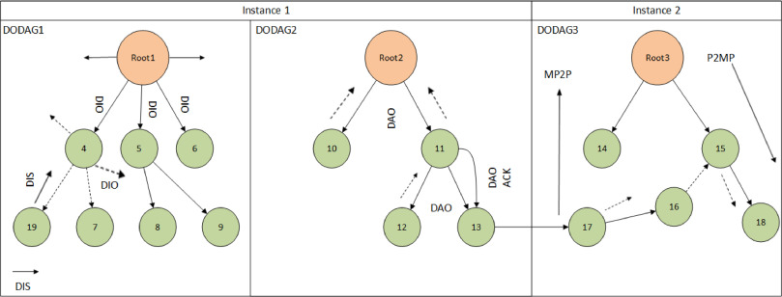
RPL
RPL is a protocol designed to be used in low-power networks in IoT.
Different types of messages are transferred between the nodes of an IoT network topology
Some RPL attacks try to send many unusual messages of a specific type in the network to lower the energy of the nodes and change the network features.
We aimed to design an Anomaly-based IDS that can detect unusual behavior (attack) in a network
3

Slide 4
Dataset
We have used the Cooja emulator to create the dataset.
We considered different numbers of nodes and different distances between them (and different PLRs) to get different networks. Then, passed each combination to the Cooja emulator to construct a network for each case. We have stored the details of each network in the other columns of our dataset.
Also, we tried to send an unusual number of each specific message to create all three mentioned RPL attacks in the project proposal.
We store such results as CSV files
80% of the non-attack dataset is used for the training
The rest of that in addition to the attack dataset is used for test
4

Slide 5
Dataset
Node Count
10, 20, 30, …, 90
Nodes distance
20, 25, 30, 35, 45
PLR
5, 10, 15, 20
Also, we have done normalization on the attribute values
4

Slide 6
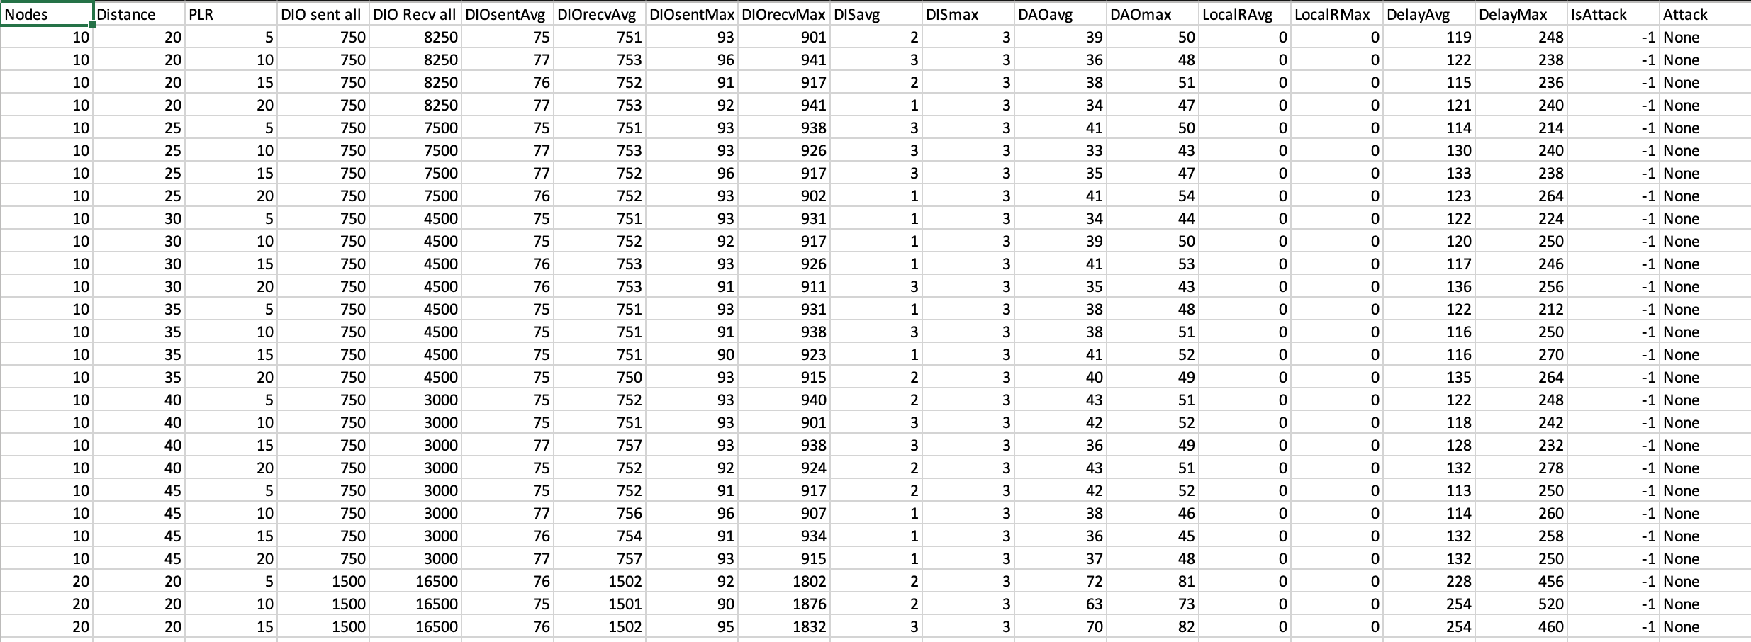
Dataset
Normal Dataset
5

Slide 7
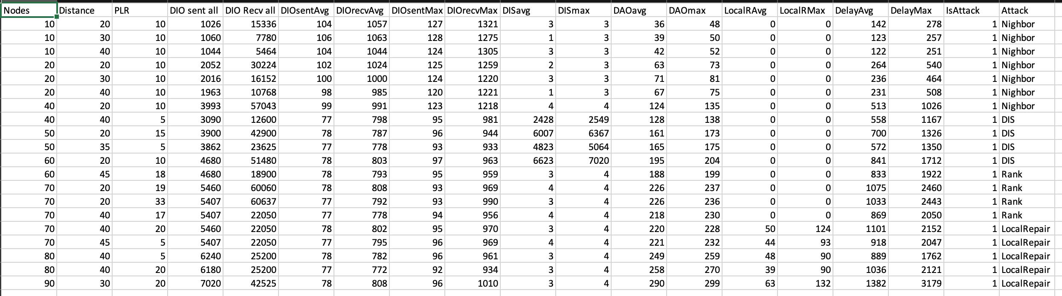
Dataset
Attack Dataset
6

Slide 8
SVM
We tried to solve this problem by OneClassSvm
Kernel: RBF
We got an accuracy of around 71% with this classifier
This approach was NOT Successful
7

Slide 9
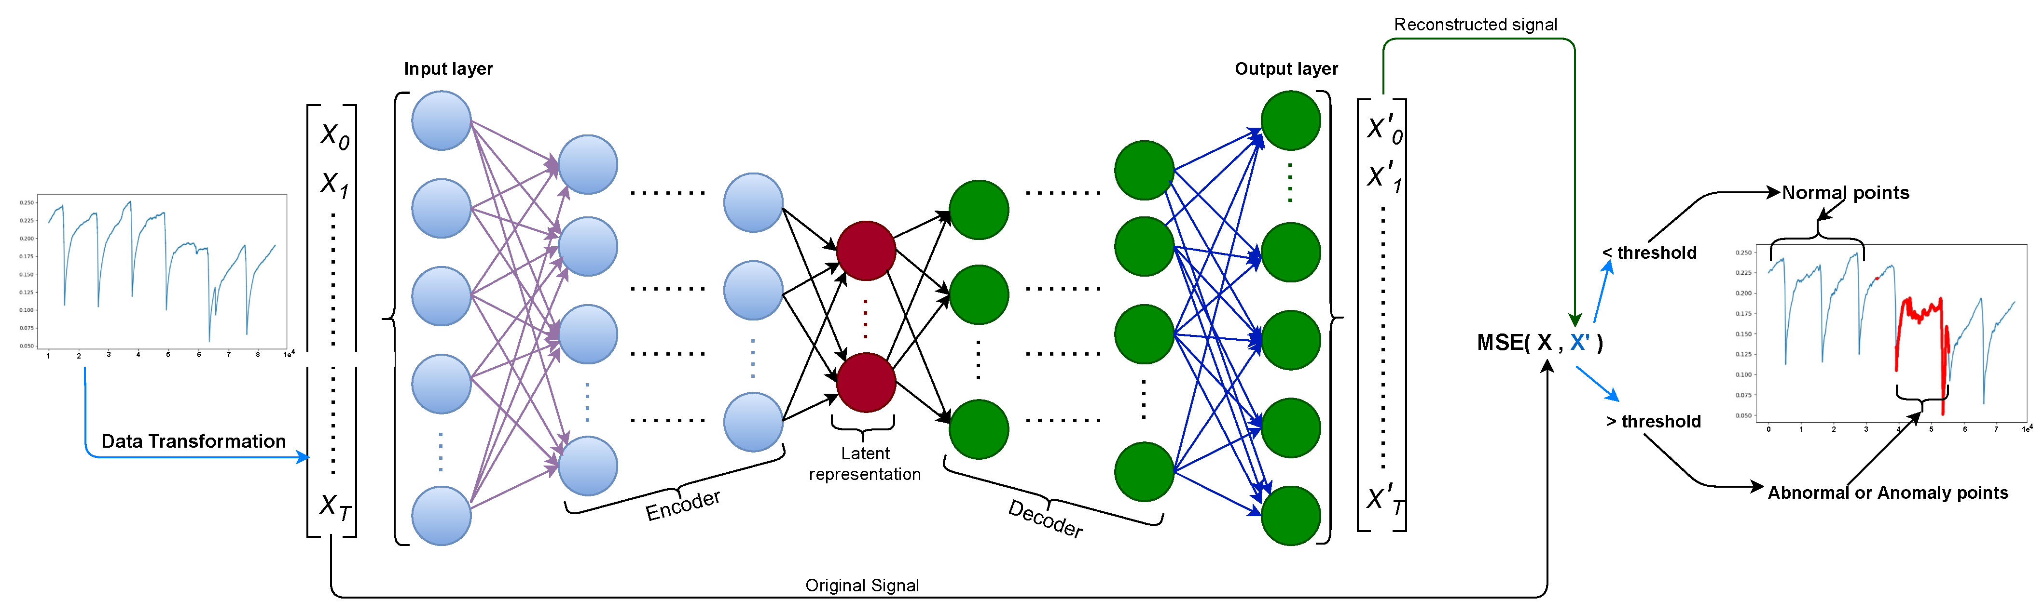
Neural Network
Autoencoder
A type of neural network that encodes the data into a lower dimension, and decodes it back to the original form
Many applications in anomaly detection
4 hidden layers are used in our proposed architecture
Hidden size = 10
8

Slide 10
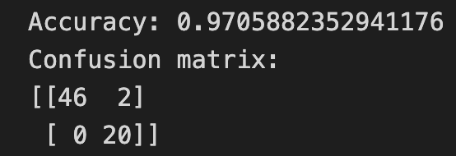
Neural Network
After training the model, we get an MSE threshold to compare the test data with that
We use the autoencoder to predict the test dataset
Finally, we classify based on it to predict if the test data is an attack or not
The result was Successful
Recall: 100%
Precision: 91%
Accuracy: 97%
9

Slide 11
Thanks!
10

